Slide 1
Web Design
by Jim Davis

Slide 2
Approaches to Design
Rules
Issues – rules are not appropriate because of the complexity. Too many rules!
Standards
Often comes down to Best Practices
Often very numerous & can conflict
Principles – which set?
Follow the platform standards
Issues?

Slide 3
Focus
What is this page about?
What are the main factors supporting the focus?

Slide 4
Design Models
Print Industry
consistency – similar appearance in layout
contrast – making differences stand out
balance – symmetry of the page
unity – what ties the pages together
emphasis – indicating what is important
PARC
Proximity – keeping things together
Alignment – lining things up (symmetry)
Repetition – use of this creates particular look
Contrast – making differences stand out

Slide 5
Principles of Design (PARC)
Proximity — group related items together on the form (what belongs together?)
Alignment — connect everything visually with the same alignment (what are four basic alignments?)
Repetition — repeat some aspect of the design throughout the entire piece (logo, font, alignment)
Contrast — if two items are not identical, then make them really different! Use space effectively! (white space)

Slide 6
White Space
Don’t make a site too busy!
This means the judicious use of white space is important
It also makes the page more effective if it is not too busy!

Slide 7
Color Models
There are many ways to describe color in web development.
Named Colors
RGB (Red Green Blue) for screens
CMYK (Cyan-Magenta-Yellow-Key) for print
HSL (Hue-Saturation-Lightness) for designers(?)

Slide 8
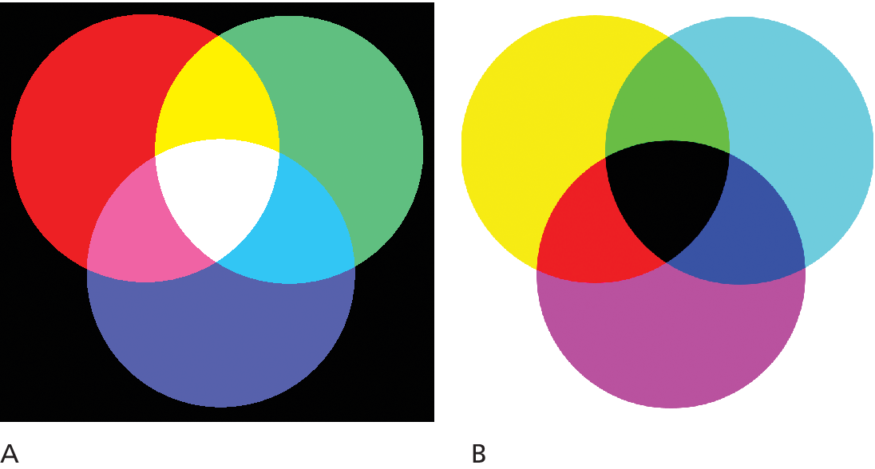
RGB Color Model
The RGB color model (Red Green Blue) relies on the fact that human visible color spectrum can be displayed using a combination of red, green, and blue lights
Each pixel is composed of tiny red, green, and blue subpixels.
Because he RGB colors combine to create white, they are also called additive colors.

Slide 9
CMYK Color Model
In the CMYK color model for Cyan-Magenta-Yellow-Key (or blacK) color is created through overlapping cyan, magenta, yellow, and black dots that create the illusion of the combined color
For this reason, these colors are called subtractive colors.
The practical consequence is that an RGB image might not look the same when it is printed on a CMYK device;

Slide 10
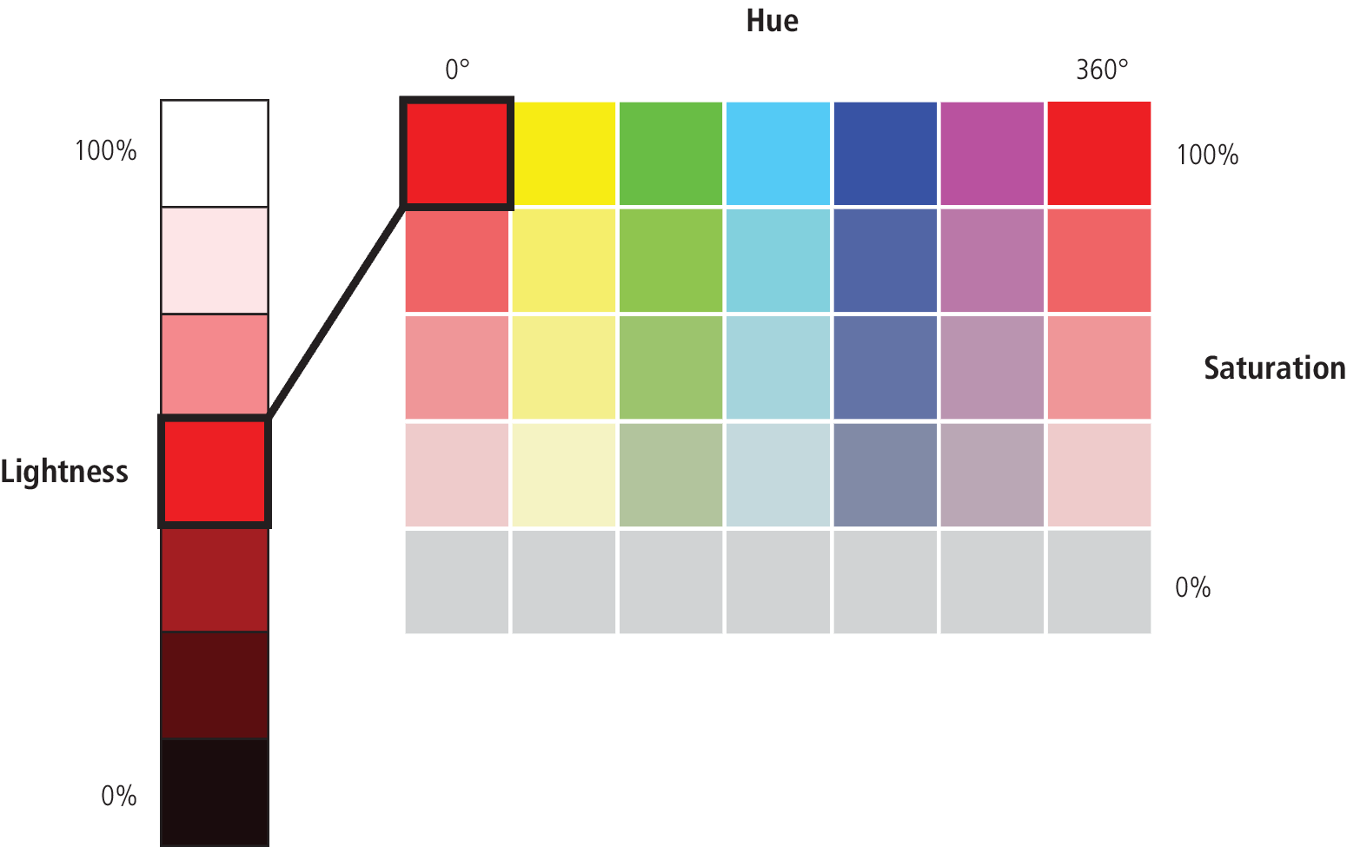
HSL color model
The HSL color model is more closely aligned to the way we generally talk about color. It breaks a color down into three components:
Hue (what we generally refer to as color)
Saturation (the intensity of a color)
Lightness (or Brightness)

Slide 11
Two Ways to Use Colour
Contrast – we want the colours to be contrast with each other.
Sometimes also called complementary
Key point is the colours are very different
Similarity – we want the colours to blend well each other.
Sometimes called analogous
Key point is the colours are closely related

Slide 12
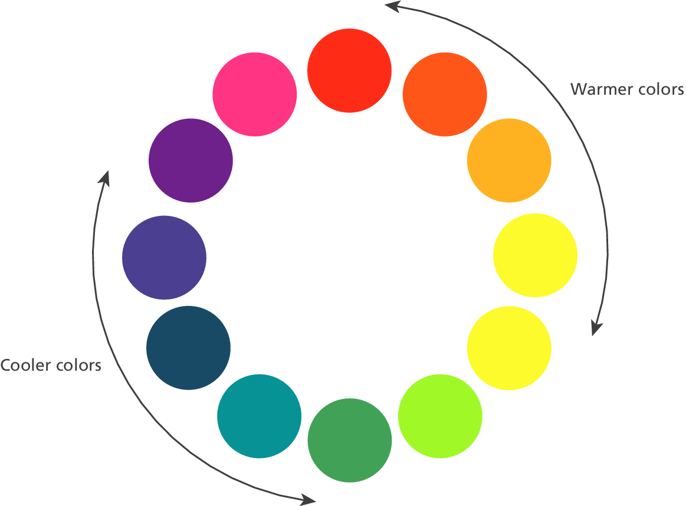
Color Relationships
Color Wheel

Slide 13
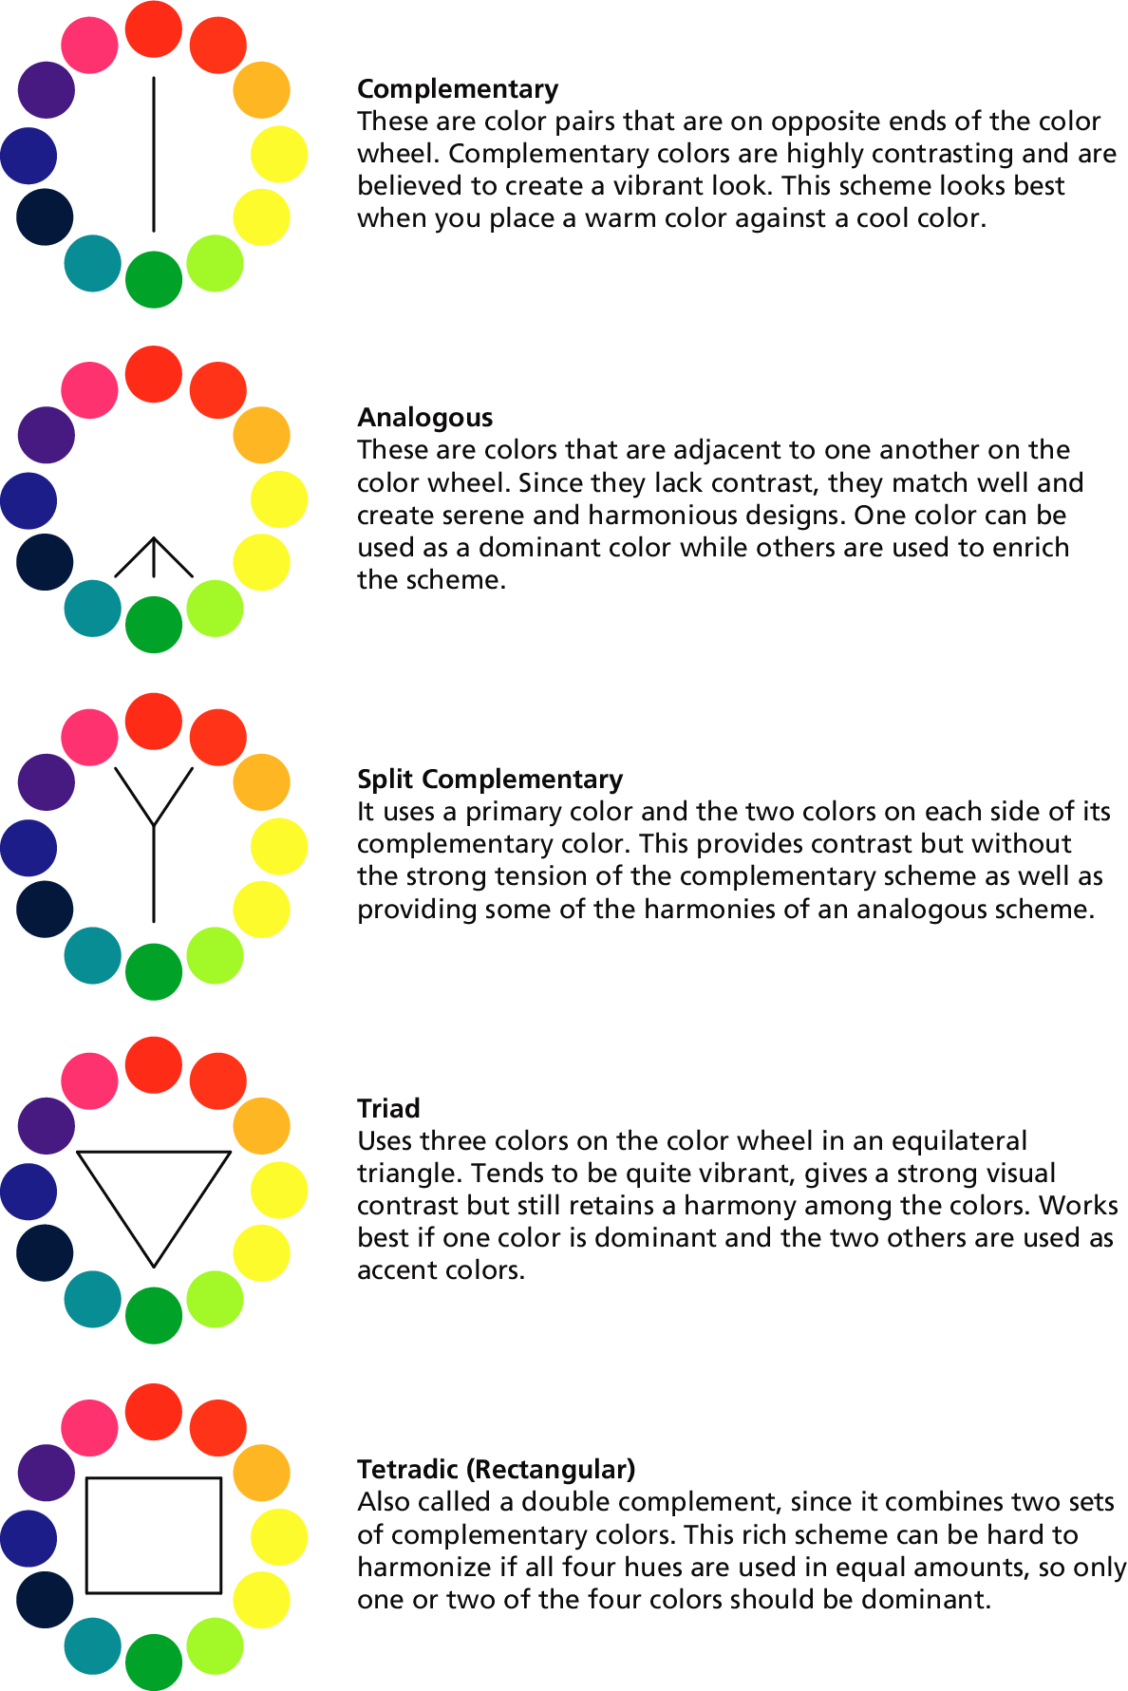
Color Relationships
Ways of picking color

Slide 14
Working with Color
If you are learning web development within a program that focuses on design, you will no doubt find (or have found) yourself spending a great deal of time learning about color relationships and color psychology.
If your program that focuses mainly on programming, will likely need to learn those concepts yourself.
If you are not completely confident in your ability to pick harmonious color combinations, there is a variety of online tools such as paletton.com, colordesigner.io, and colormind.io
Most web user interfaces typically need six or seven variations (shades) of three or four colors

Slide 15
Crash Course in Using Colour
Foreground and Background colour should maximize contrast!
White text on a pastel background has poor contrast.
Instead use a saturated (intense) colour on a pastel background or vica versa.
Avoid Red/Green combinations, red/green colour blindness is the most common.
KIS – Keep it Simple!
Starting out use fewer colours.
When you are comfortable try adding another colour or shade.

Slide 16
Any Question?

